Slide 1
IP Addressing
Notes:
Cisco Networking Academy program
Introduction to Networks
Chapter 8: IP Addressing

Slide 2
IPv4 Network Addresses
Notes:
8.1 IPv4 Network Addresses

Slide 3
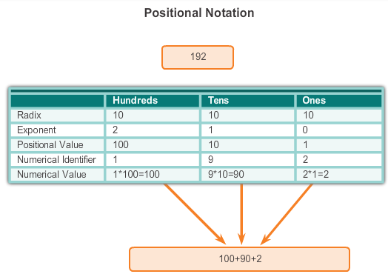
IPv4 Address Structure
Binary Notation
Binary notation refers to the fact that computers communicate in 1s and 0s
Positional notation - converting binary to decimal requires an understanding of the mathematical basis of a numbering system
Notes:
8.1.1.1 Binary Notation

Slide 4

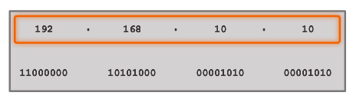


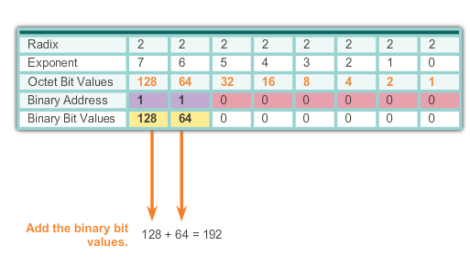
IPv4 Address Structure
Binary Number System
Notes:
8.1.1.2 Binary Number System

Slide 5


IPv4 Address Structure
Converting a Binary Address to Decimal
Practice
Notes:
8.1.1.3 Converting a Binary Address to Decimal

Slide 6
IPv4 Address Structure
Converting a Binary Address to Decimal
Practice
Answer = 176
Answer = 255
Notes:
8.1.1.3 Converting a Binary Address to Decimal

Slide 7
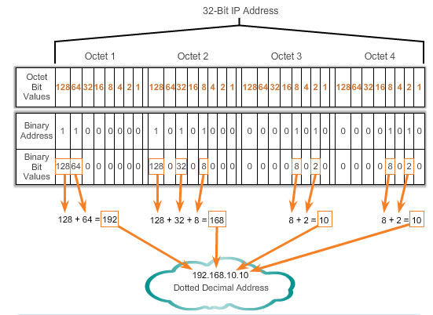
IPv4 Address Structure
Converting a Binary Address to Decimal
Notes:
Section 8.1.1.3 & 8.1.1.4 Converting a Binary Address to Decimal

Slide 8
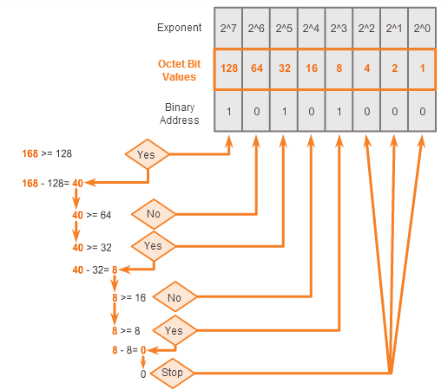
IPv4 Address Structure
Converting from Decimal to Binary
168 = ? binary
Notes:
8.1.1.5 Converting from Decimal to Binary

Slide 9
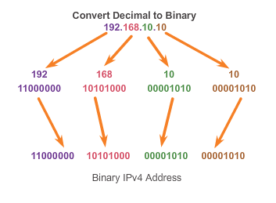
IPv4 Address Structure
Converting from Decimal to Binary (Cont.)
Notes:
8.1.1.6 Converting from Decimal to Binary (Cont.)

Slide 10
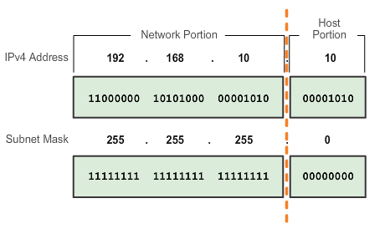
IPv4 Subnet Mask
Network Portion and Host Portion of an IPv4 Address
To define the network and host portions of an address, a devices use a separate 32-bit pattern called a subnet mask
The subnet mask does not actually contain the network or host portion of an IPv4 address, it just says where to look for these portions in a given IPv4 address
Notes:
8.1.2.1 Network Portion and Host Portion of an IPv4 Address

Slide 11
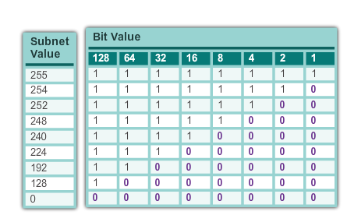
IPv4 Subnet Mask
Network Portion and Host Portion of an IPv4 Address (cont.)
Valid Subnet Masks
Notes:
8.1.2.1 Network Portion and Host Portion of an IPv4 Address (cont.)

Slide 12
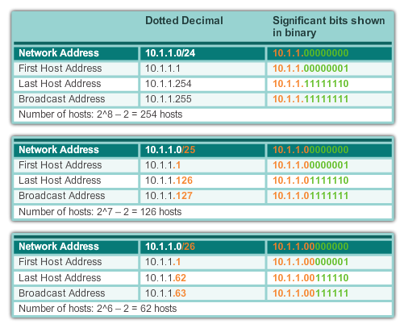
IPv4 Subnet Mask
Examining the Prefix Length
Notes:
8.1.2.2 Examining the Prefix Length

Slide 13
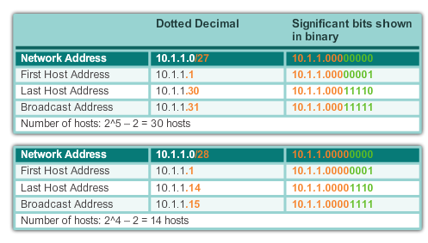
IPv4 Subnet Mask
Examining the Prefix Length (cont.)
Notes:
8.1.2.2 Examining the Prefix Length (cont.)

Slide 14
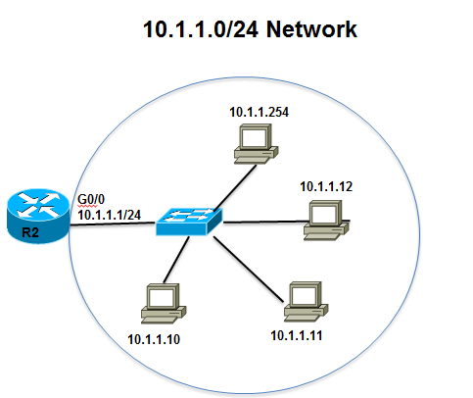
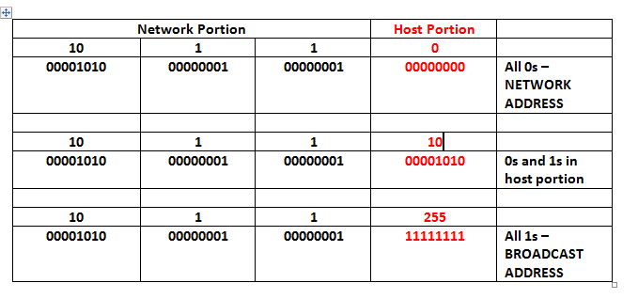
IPv4 Subnet Mask
IPv4 Network, Host, and Broadcast Address
10.1.1.0/24
Notes:
8.1.2.3 IPv4 Network, Host and Broadcast Address

Slide 15
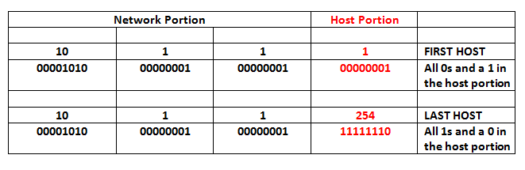
IPv4 Subnet Mask
First Host and Last Host Addresses
10.1.1.0/24
Notes:
8.1.2.4 First Host and Last Host Addresses

Slide 16
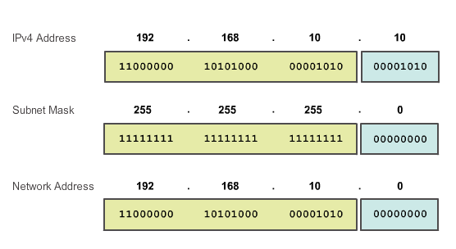
IPv4 Subnet Mask
Bitwise AND Operation
1 AND 1 = 1 1 AND 0 = 0 0 AND 1 = 0 0 AND 0 = 0
Notes:
8.1.2.5 and 8.1.2.6 Bitwise AND Operation/Importance of ANDing

Slide 17
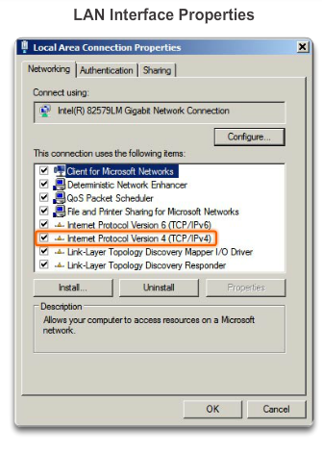
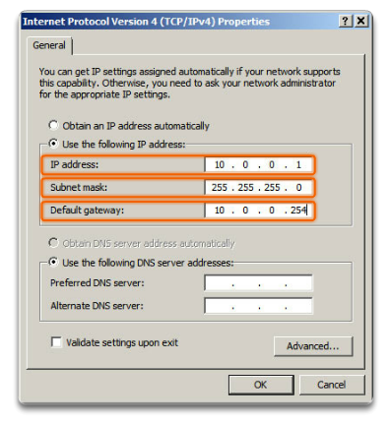
IPv4 Unicast, Broadcast, and Multicast
Assigning a Static IPv4 Address to a Host
LAN Interface Properties
Configuring a Static IPv4 Address
Notes:
8.1.3.1 Assigning a Static IPv4 Address to a Host

Slide 18
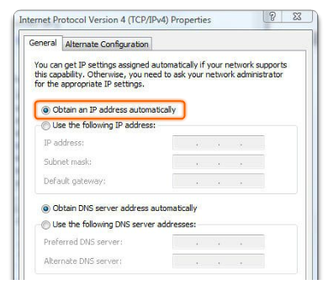
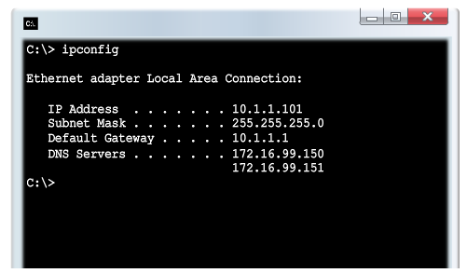
IPv4 Unicast, Broadcast, and Multicast
Assigning a Dynamic IPv4 Address to a Host
Verification
DHCP – The preferred method of assigning IPv4 addresses to hosts on large networks because it reduces the burden on network support staff and virtually eliminates entry errors.
Notes:
8.1.3.2 Assigning a Dynamic IPv4 Address to a Host

Slide 19
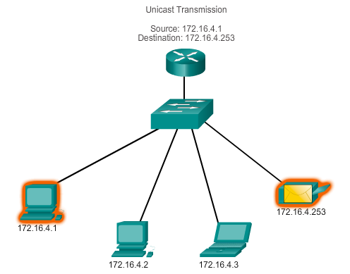
IPv4 Unicast, Broadcast, and Multicast
Unicast Transmission
In an IPv4 network, the hosts can communicate one of three different ways:
Unicast, Broadcast, and Multicast
#1 Unicast – the process of sending a packet from one host to an individual host.
Notes:
8.1.3.3 Unicast Transmission

Slide 20
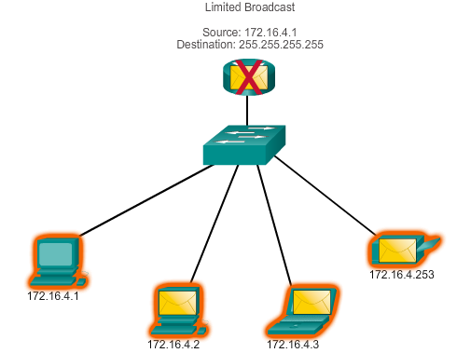
IPv4 Unicast, Broadcast, and Multicast
Broadcast Transmission
In an IPv4 network, the hosts can communicate one of three different ways: Unicast, Broadcast, and Multicast.
#2 Broadcast – the process of sending a packet from one host to all hosts in the network.
Directed broadcast
Destination 172.16.4.255
Hosts within the 172.16.4.0/24 network
NOTE: Routers do not forward a limited broadcast!
Directed broadcast
Destination 172.16.4.255
Hosts within the 172.16.4.0/24 network
Notes:
8.1.3.4 Broadcast Transmission

Slide 21
IPv4 Unicast, Broadcast, and Multicast
Multicast Transmission
In an IPv4 network, the hosts can communicate one of three different ways: Unicast, Broadcast, and Multicast.
#3 Multicast – The process of sending a packet from one host to a selected group of hosts, possibly in different networks.
Reduces traffic
Reserved for addressing multicast groups – 224.0.0.0 to 239.255.255.255.
Link local – 224.0.0.0 to 224.0.0.255 (Example: routing information exchanged by routing protocols)
Globally scoped addresses – 224.0.1.0 to 238.255.255.255 (Example: 224.0.1.1 has been reserved for Network Time Protocol)
Notes:
8.1.3.5 Multicast Transmission

Slide 22
Types of IPv4 Address
Public and Private IPv4 Addresses
Private address blocks are:
Hosts that do not require access to the Internet can use private addresses
  10.0.0.0 to 10.255.255.255 (10.0.0.0/8)
  172.16.0.0 to 172.31.255.255 (172.16.0.0/12)
  192.168.0.0 to 192.168.255.255 (192.168.0.0/16)
Shared address space addresses:
Not globally routable
Intended only for use in service provider networks
Address block is 100.64.0.0/10
Notes:
8.1.4.1 Public and Private IPv4 Addresses

Slide 23
Types of IPv4 Address
Special Use IPv4 Addresses
Network and Broadcast addresses – within each network the first and last addresses cannot be assigned to hosts
Loopback address – 127.0.0.1 a special address that hosts use to direct traffic to themselves (addresses 127.0.0.0 to 127.255.255.255 are reserved)
Link-Local address – 169.254.0.0 to 169.254.255.255 (169.254.0.0/16) addresses can be automatically assigned to the local host
TEST-NET addresses – 192.0.2.0 to 192.0.2.255 (192.0.2.0/24) set aside for teaching and learning purposes, used in documentation and network examples
Experimental addresses – 240.0.0.0 to 255.255.255.254 are listed as reserved
Notes:
8.1.4.3 Special Use IPv4 Addresses

Slide 24
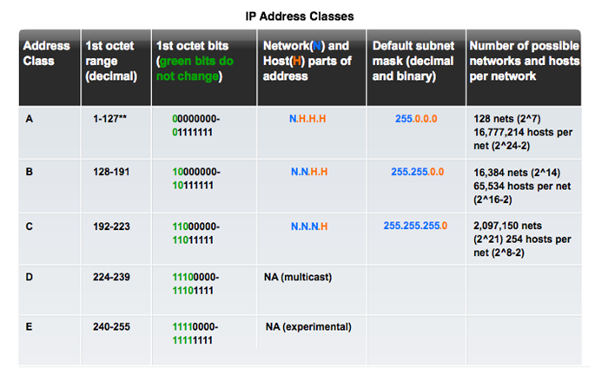
Types of IPv4 Address
Legacy Classful Addressing
See if updated graphic with top row in text case for consistency.
Notes:
8.1.4.4 Legacy Classful Addressing

Slide 25
Types of IPv4 Address
Legacy Classful Addressing (cont.)
Classless Addressing
Formal name is Classless Inter-Domain Routing (CIDR, pronounced “cider
Created a new set of standards that allowed service providers to allocate IPv4 addresses on any address bit boundary (prefix length) instead of only by a class A, B, or C address
Notes:
8.1.4.4 Legacy Classful Addressing (cont.)

Slide 26

Types of IPv4 Address
Assignment of IP Addresses
Regional Internet Registries (RIRs)
Notes:
8.1.4.5 Assignment of IP Addresses

Slide 27
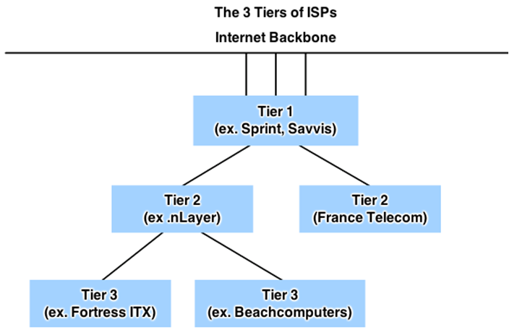
Types of IPv4 Address
Assignment of IP Addresses (Cont.)
ISPs are large national or international ISPs that are directly connected to the Internet backbone.
Tier 2 ISPs generally focus on business customers.
Tier 3 ISPs often bundle Internet connectivity as a part of network and computer service contracts for their customers.
Tier 3 ISPs purchase their Internet service from Tier 2 ISPs.
Notes:
8.1.4.6 Assignment of IP Addresses (Cont.)

Slide 28
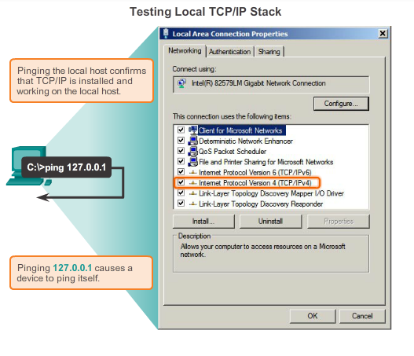
Testing and Verification
Ping – Testing the Local Stack
Notes:
8.3.2.1 Ping – Testing the Local Stack

Slide 29
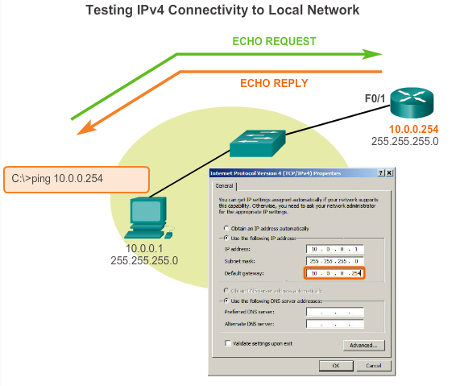
Testing and Verification
Ping – Testing Connectivity to the Local LAN
Notes:
8.3.2.2 Ping – Testing Connectivity to the Local LAN

Slide 30
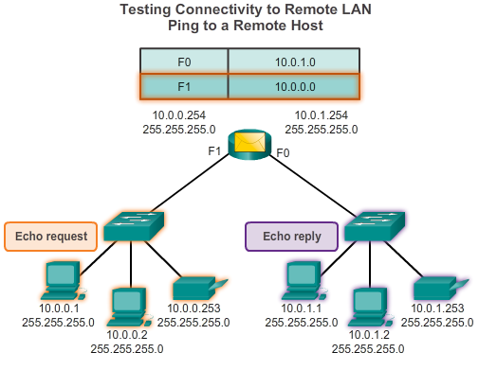
Testing and Verification
Ping – Testing Connectivity to Remote
Notes:
8.3.2.3 Ping – Testing Connectivity to Remote

Slide 31
Testing and Verification
Traceroute – Testing the Path
  Traceroute
  Generates a list of hops that were successfully reached along the path.
  Provides important verification and troubleshooting information.
  If the data reaches the destination, then the trace lists the interface of every router in the path between the hosts.
  If the data fails at some hop along the way, the address of the last router that responded to the trace can provide an indication of where the problem or security restrictions are found.
  Provides round-trip time for each hop along the path and indicates if a hop fails to respond.
Notes:
8.3.2.4 Traceroute – Testing the Path

Slide 32
IP Addressing
Summary
IP addresses are hierarchical with network, subnetwork, and host portions.
An IP address can represent a complete network, a specific host, or the broadcast address of the network.
The subnet mask or prefix is used to determine the network portion of an IP address. Once implemented, an IP network needs to be tested to verify its connectivity and operational performance.
DHCP enables the automatic assignment of addressing information such as IP address, subnet mask, default gateway, and other configuration information.
Notes:
Summary

Slide 33
IP Addressing
Summary (cont.)
IPv4 hosts can communicate one of three different ways: unicast, broadcast, and multicast.
The private IPv4 address blocks are: 10.0.0.0/8, 172.16.0.0/12, and 192.168.0.0/16.
The depletion of IPv4 address space is the motivating factor for moving to IPv6.
Each IPv6 address has 128 bits verses the 32 bits in an IPv4 address.
The prefix length is used to indicate the network portion of an IPv6 address using the following format: IPv6 address/prefix length.
Notes:
Summary

